Slide 1

Project name Common service portal
Team – Guided by –
Sanket Kharade. Miss – Kiran Tiwari
Saloni Sabale. Batch - J41
Varsha Aware.

Slide 2

Common service portal
One stop for every aspirant

Slide 3
Index
Project Objective
Project Description
Technologies
Development Phases
ER Diagram
Project Lifecycle
Backend Architecture
Frontend Architecture
Databases
Postman operations
Applications
Conclusion
Live demo

Slide 4
Project Objective
To create a user-friendly platform that aggregates scholarship opportunities.
To provide personalized scholarship recommendations based on student profiles.
To facilitate the application process for multiple scholarships through a single portal.
To minimize the time and efforts for user and the universities
To provide the exposure and enhance the user experience of the users through user friendly and simple application

Slide 5
Project Description
Centralized Scholarship Hub : The project aims to create a unified platform where students can effortlessly apply for a diverse range of scholarships tailored to their individual preferences, eligibility criteria, and academic needs.
Inclusive Access : It ensures equitable access for students from all educational backgrounds, enabling them to explore and apply for various ongoing and forthcoming scholarships from government entities, private organizations, and other sources.
Streamlined Application Process : By providing a centralized access point, the project simplifies the scholarship application process, making it more efficient and user-friendly for students seeking financial aid for their studies.
Comprehensive Scholarship Information : The platform will serve as a comprehensive repository of information on scholarships, offering detailed insights into each scheme, including application deadlines, requirements, and benefits

Slide 6
Technologies
Frontend – HTML, CSS, Bootstrap, JavaScript
Framework – Angular
Backend – Spring Boot
API – REST
Client – Postman
IDE - Eclipse

Slide 7
Development phases
Problem statement
Analysis
Design
Development
Testing

Slide 8
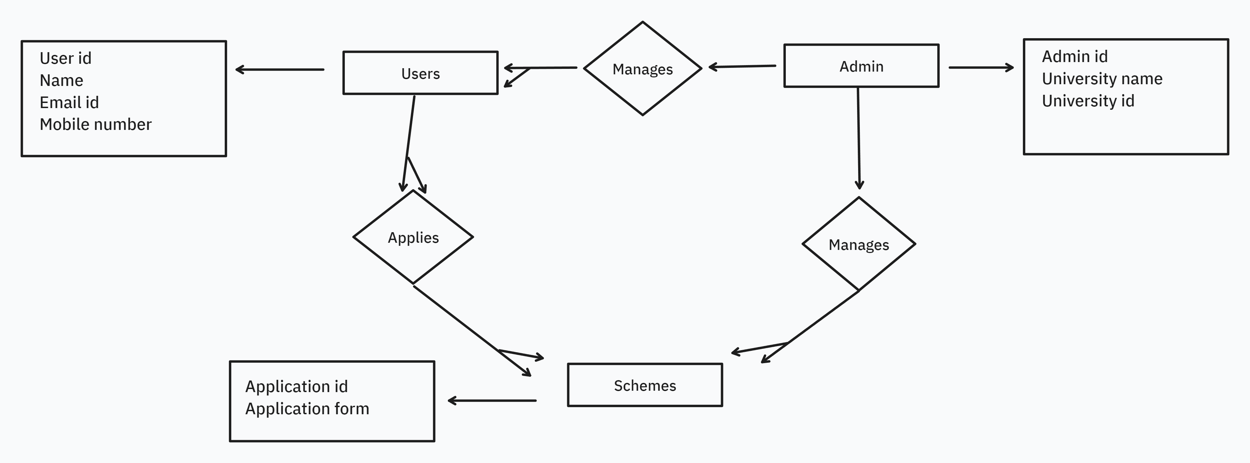
ER Diagram

Slide 9
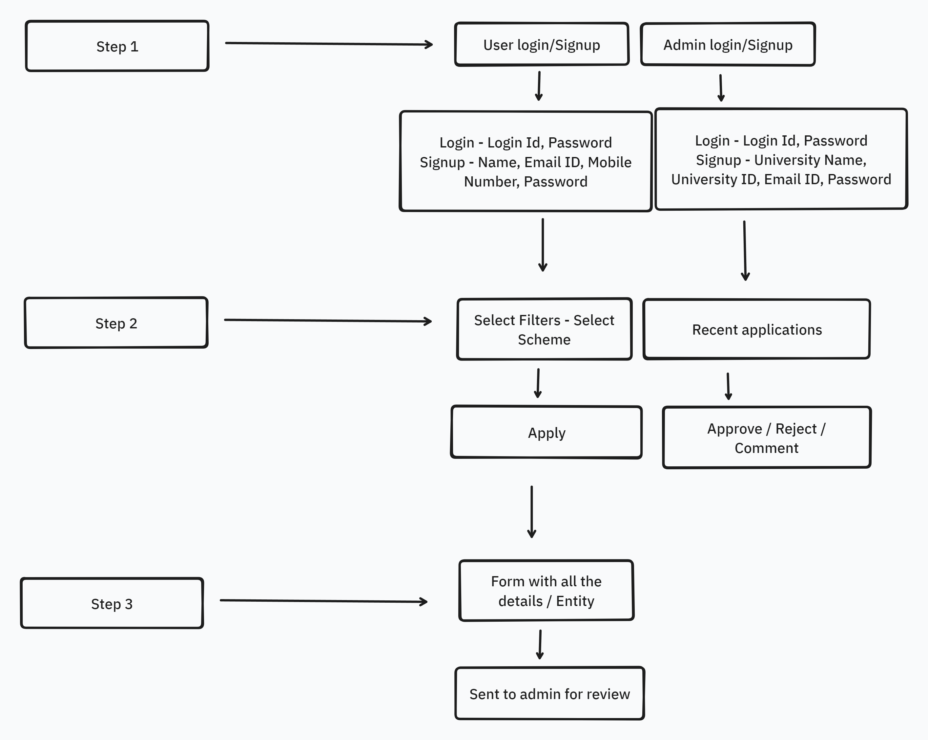
Project Lifecycle

Slide 10
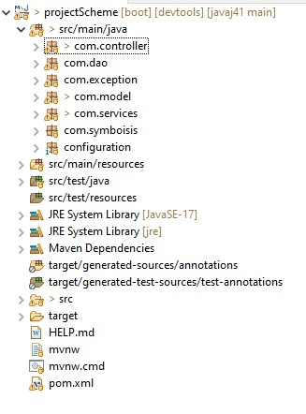
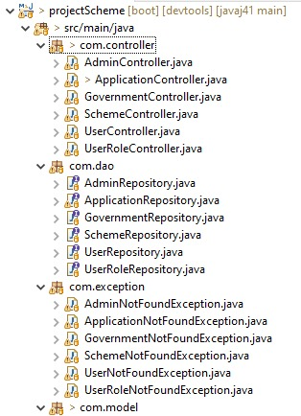
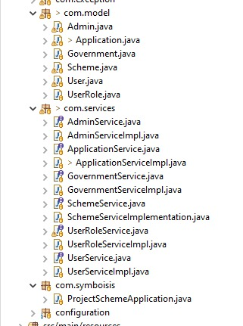
Backend architecture

Slide 11
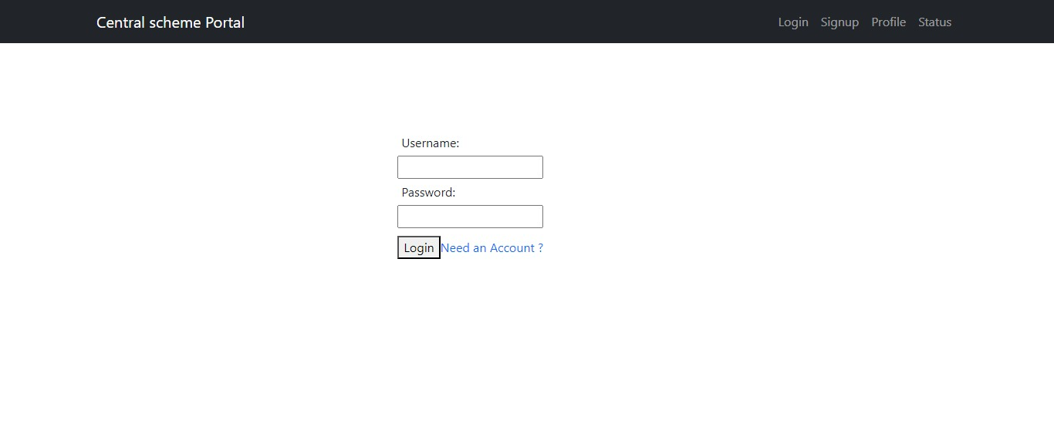
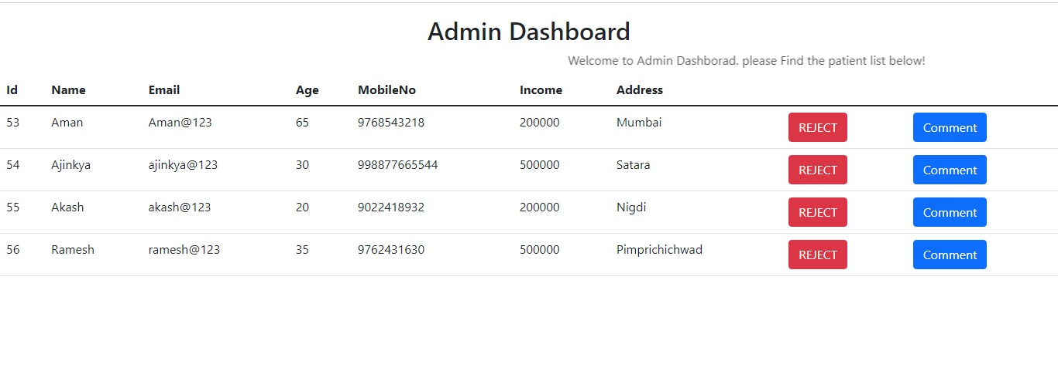
Frontend architecture

Slide 12
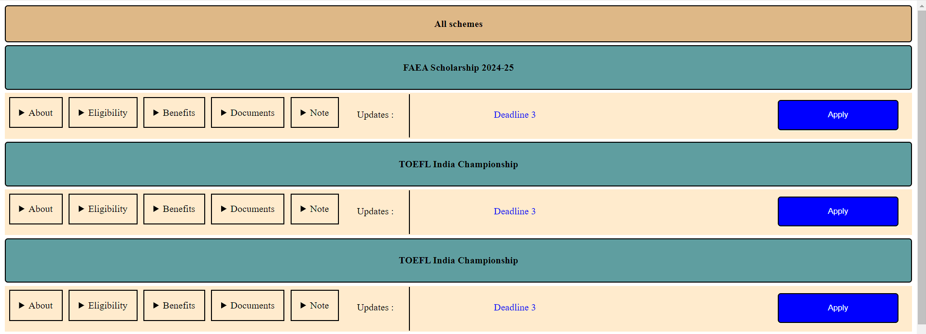
Frontend architecture

Slide 13
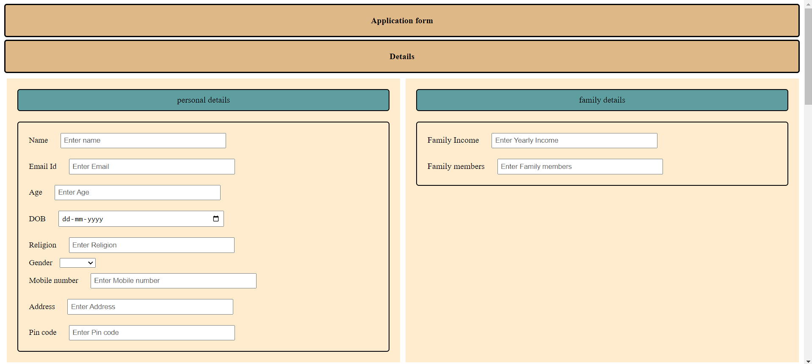
Frontend architecture

Slide 14
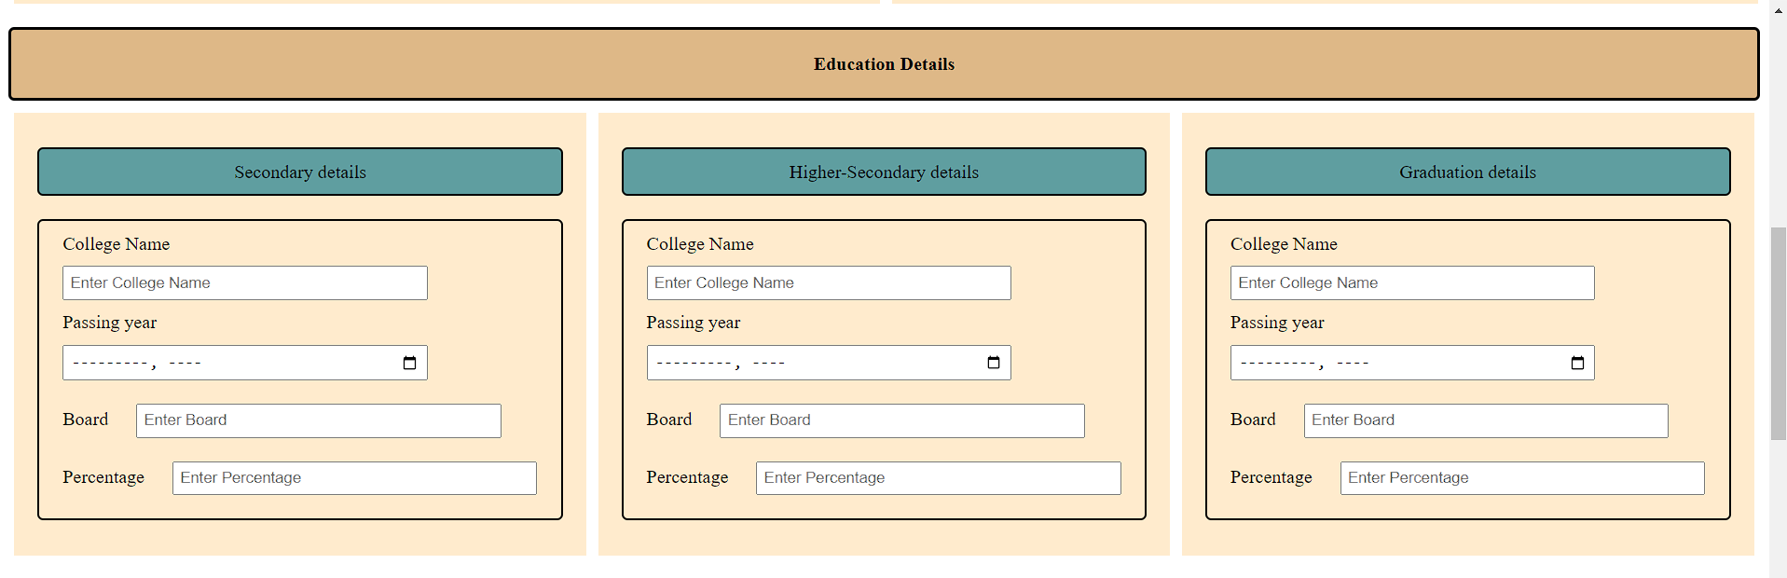

Frontend architecture

Slide 15
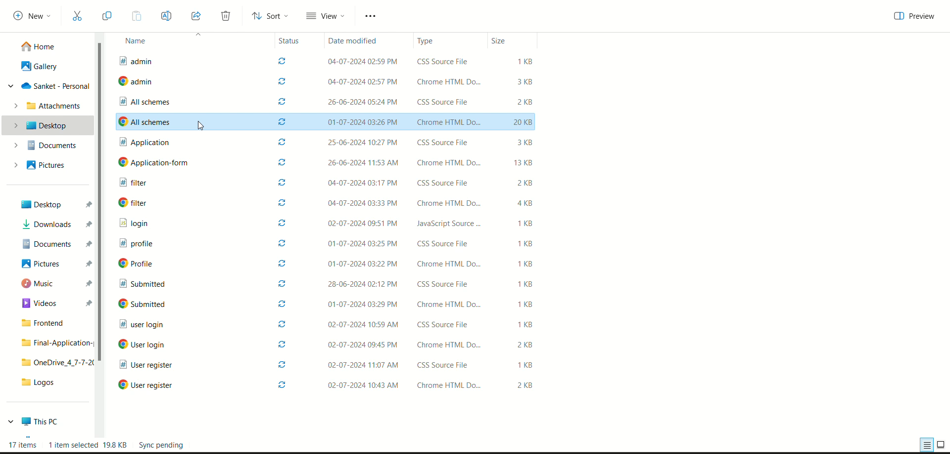
Frontend architecture

Slide 16
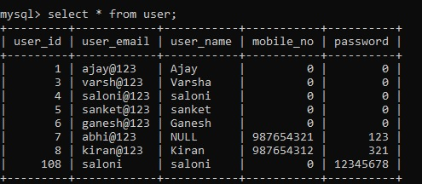
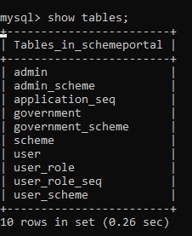
Databases

Slide 17
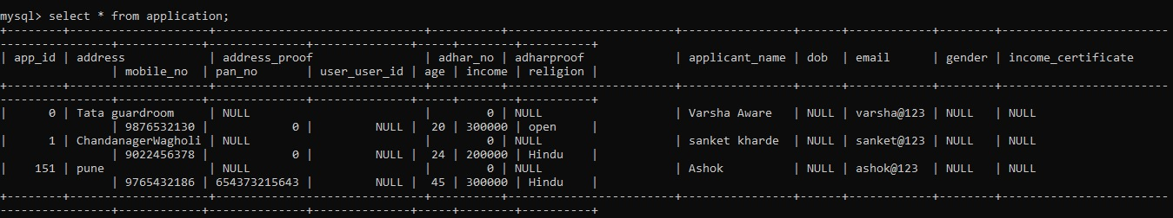
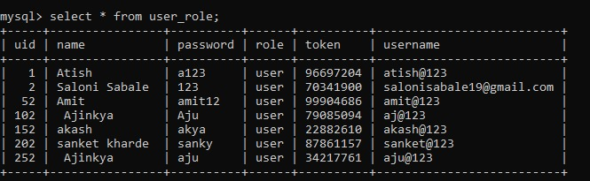
Databases

Slide 18
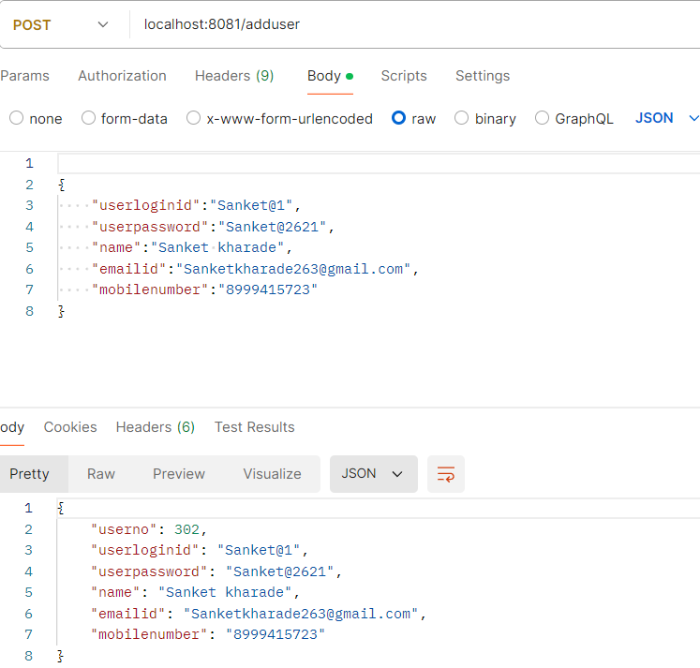
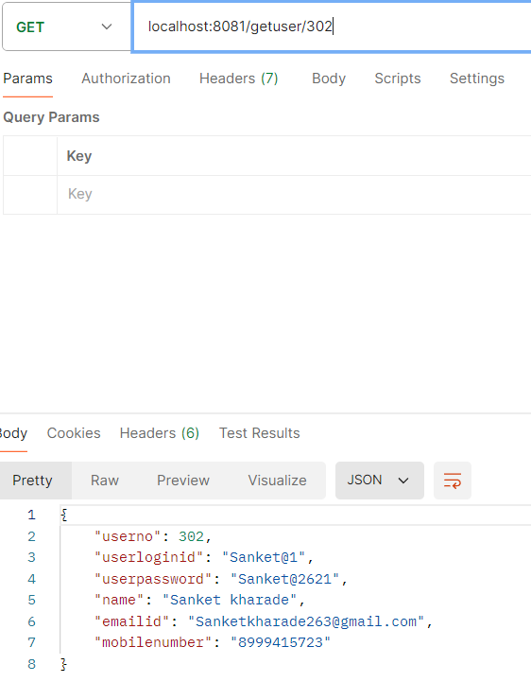
Postman operations

Slide 19
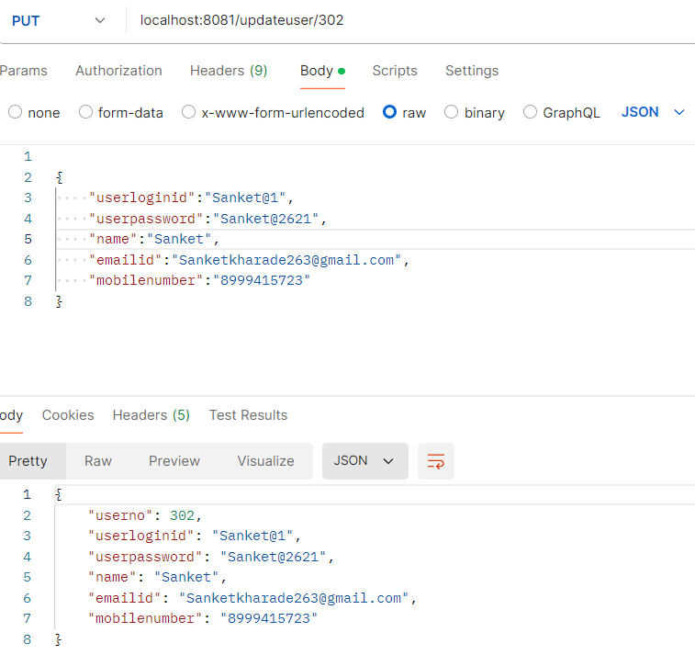
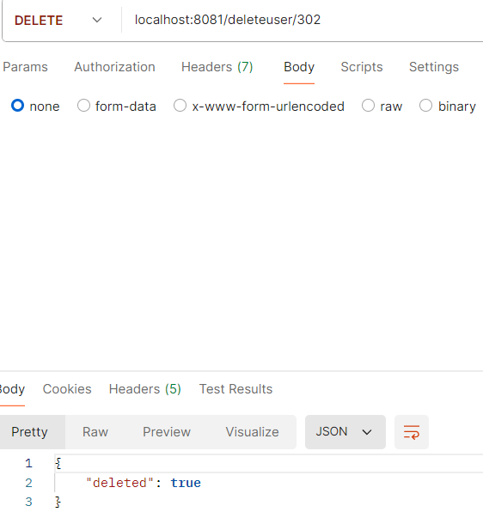
Postman operations

Slide 20
Applications
To provide scholarships by universities
In scholarships provided by private organizations as a CSR initiative
Government schemes and apprenticeships
Document verification
Job and other schemes updates

Slide 21
Conclusion
In conclusion, the outlined objectives emphasize the creation of a comprehensive, user-friendly scholarship platform.
This platform aims to aggregate various scholarship opportunities, offer personalized recommendations tailored to student profiles, and streamline the application process through a single portal.
By minimizing the time and effort required from both users and universities, the platform seeks to enhance efficiency.
Additionally, it prioritizes user experience by providing a simple and intuitive application process, ultimately facilitating greater exposure to available scholarships and ensuring a seamless and supportive experience for all users

Slide 22
Thank you

Slide 23
Live Demo…..

